Slide 1
Implementation of association in java

Slide 2
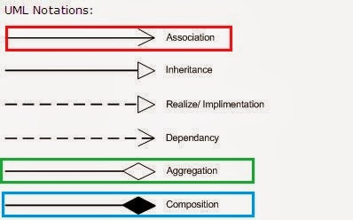
UML Diagram of Association, Composition and Aggregation

Slide 3
Association
Different forms of Association:
Association
Aggregation
Composition

Slide 4
Association
class HardDisk {
public void writeData(String data) {
System.out.println("Data is being written : " + data);
} }
class UseDell {
// segate is referece of HardDisk class in UseDell class.
//So, UseDell Has-A HardDisk
HardDisk segate = new HardDisk();
public void save (String data) {
segate.writeData(data);
} }

Slide 5
Aggregation
Example: Organization has Person as employees, relationship between them is Aggregation.
Implementation of Aggregation:
public class Organization {
private List employees;
hireEmployee(Person p){
Employees.add(p);
} }
public class Person {
private String name;
}
public class Main{
public static void main(String arg[]){
Person p=new Person();
Organization c=new Organization();
c.hireEmployee(p);
}}

Slide 6
Composition
Example: Since Engine is part-of Car, relationship between them is Composition.
Implementation of composition:
public class Car {
//final will make sure engine is initialized
private final Engine engine;
public Car(){
engine = new Engine();
}
}
class Engine {
private String type;
}

Slide 7

Implementing a bi-directional association
public class Department {
private Set staff = new HashSet();
...
}
public class Employee {
private Department department;
...
}

Slide 8
Thank You

